Slide 1


The Nanum font provided by Naver is applied to this presentation. Photo by FadiXd on Unsplash
.NET Conf 2022 x Seoul
Are you ready to fall in love with Full Stack?

Slide 2


Presentation Title
Speaker name

Slide 3
Single column of content

Slide 4
Two columns of content

Slide 5
Demo
Simple Description

Slide 6
Code Sample
Code Sample

Slide 7
Announcement
Value prop 1
Value prop 2
Value prop 3

Slide 8
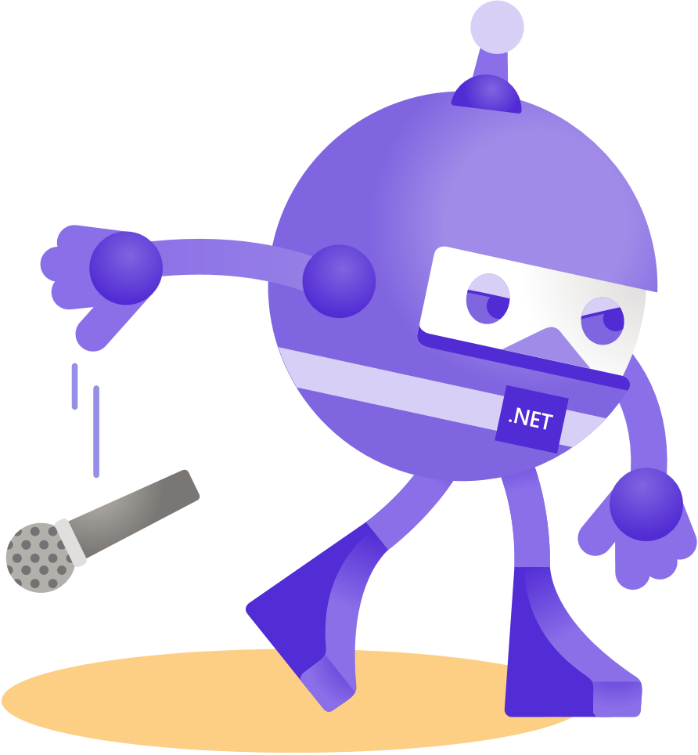
Thanks for joining!

Slide 9









Slide 10








Slide 11








Slide 12







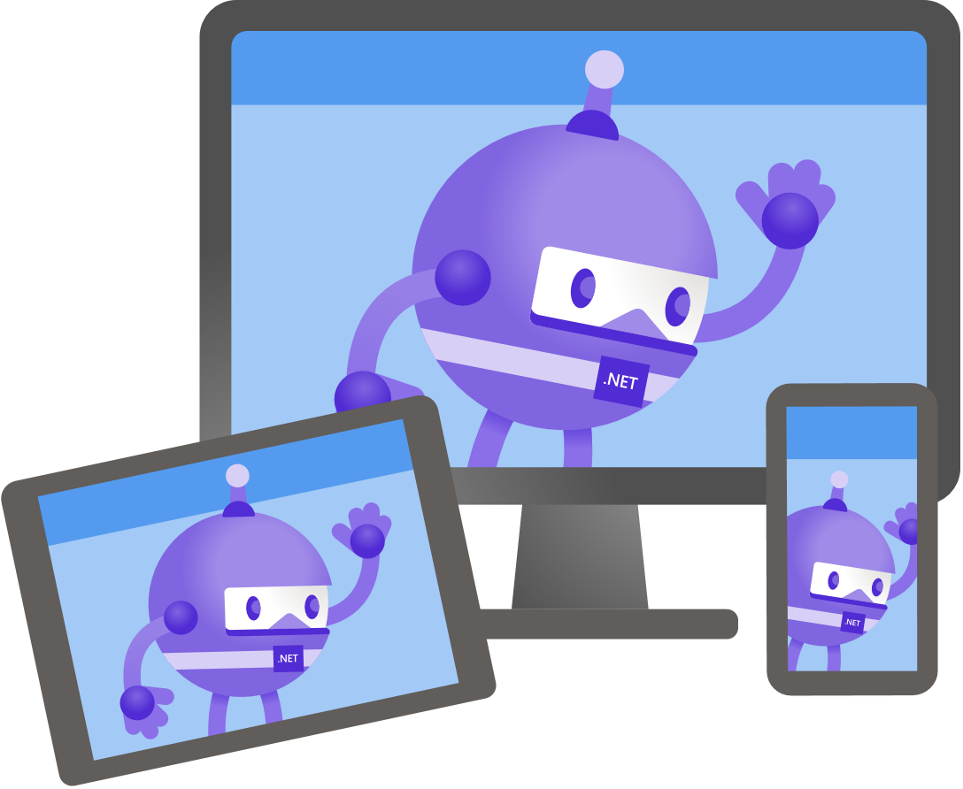

Slide 13





Slide 14


Slide 15


Slide 16


Slide 17


Slide 18


